Slide 1


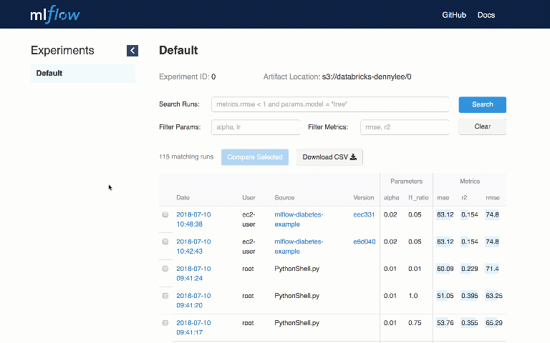
MLflow is an open source platform to manage the ML lifecycle, including experimentation, reproducibility and deployment

Slide 2

Why we use it?
There are a myriad tools.
It’s hard to track experiments
It’s hard to reproduce results
It’s hard to deploy ML
For these reasons many organizations have started to build internal machine learning platforms to manage the ML lifecycle, but these platforms are limited:
support a small set of algorithms
single ML library

Slide 3
MLflow: an Open Machine Learning Platform
Open interface: MLflow is designed to work with any ML library, algorithm, deployment tool or language
Open source: mlflow is meant to be open source in such a way that developers can extend it. In addition, MLflow’s open format makes it very easy to share workflow steps and models across organizations.

Slide 4
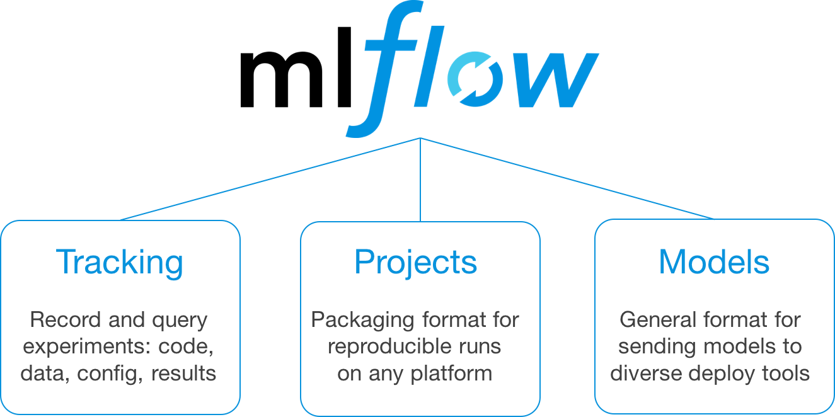
ML flow: 3 components
ML flow is still in alpha version but offer 3 components:
Notes:
What can we do with ML Flow?

Slide 5
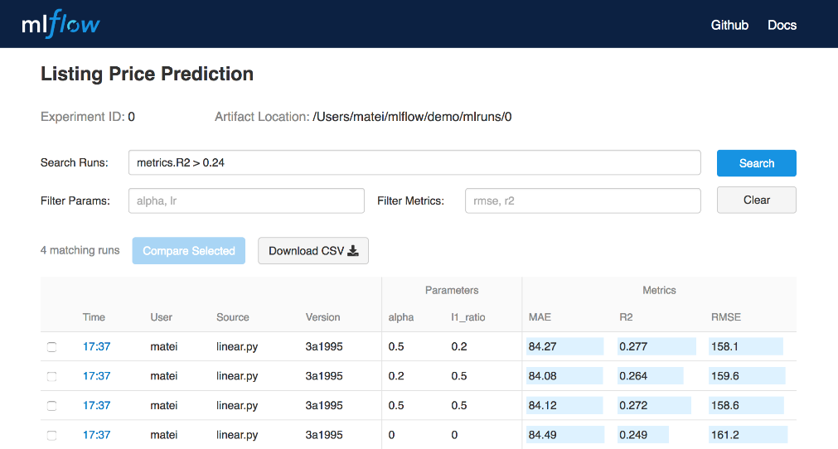
ML Flow Tracking
MLflow Tracking is an API and UI for logging parameters, code versions, metrics and output files when running your machine learning code to later visualize them. With a few simple lines of code, you can track parameters, metrics, and artifacts
You can use MLflow Tracking in any environment (for example, a standalone script or a notebook) to log results to local files or to a server, then compare multiple runs. Using the web UI, you can view and compare the output of multiple runs. Teams can also use the tools to compare results from different users

Slide 6
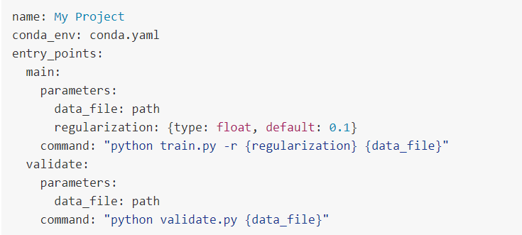
ML Flow Project
MLflow Projects provide a standard format for packaging reusable data science code. Each project is simply a directory with code or a Git repository; a MLflow Project is defined by a simple YAML file called MLproject.

Slide 7
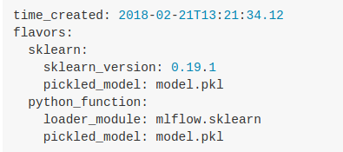
ML Flow Model
MLflow Models is a convention for packaging machine learning models in multiple formats called “flavors”. MLflow offers a variety of tools to help to deploy different flavors of models. Each MLflow Model is saved as a directory containing arbitrary files and an MLmodel descriptor file that lists the flavors it can be used in.
In this example, the model can be used with tools that support either the “sklearn” or “python_function” model flavors.

Slide 8
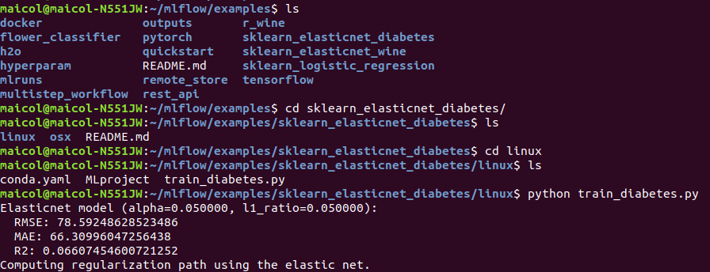
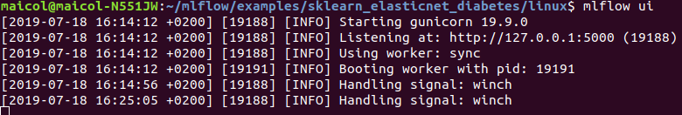
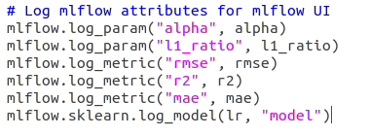
Sklearn and MLFlow
Now I want to show you an example that runs MLFlow with Sklearn .
1) Let's go to the folder and start the program
2) Let's start MLFlow interface
3) Code to add to track parameters

Slide 9
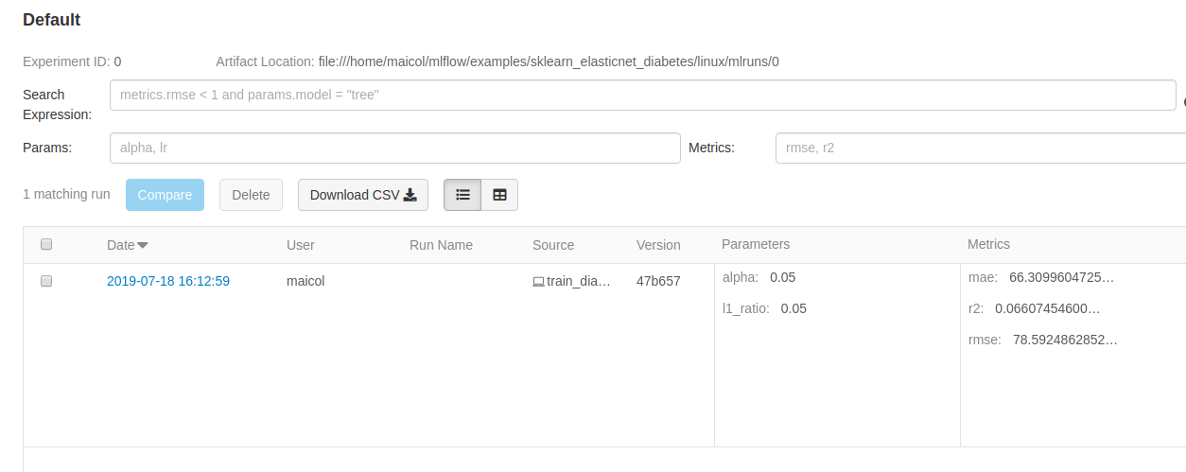
What we see in MLFlow UI
MLFlow User Interface is a Dashboard of our Machine Learning projects.
In this part we can see:
- Number of instances that we run
- Our parameters
- Our metrics
We can also search expressions or parameters of our projects

Slide 10
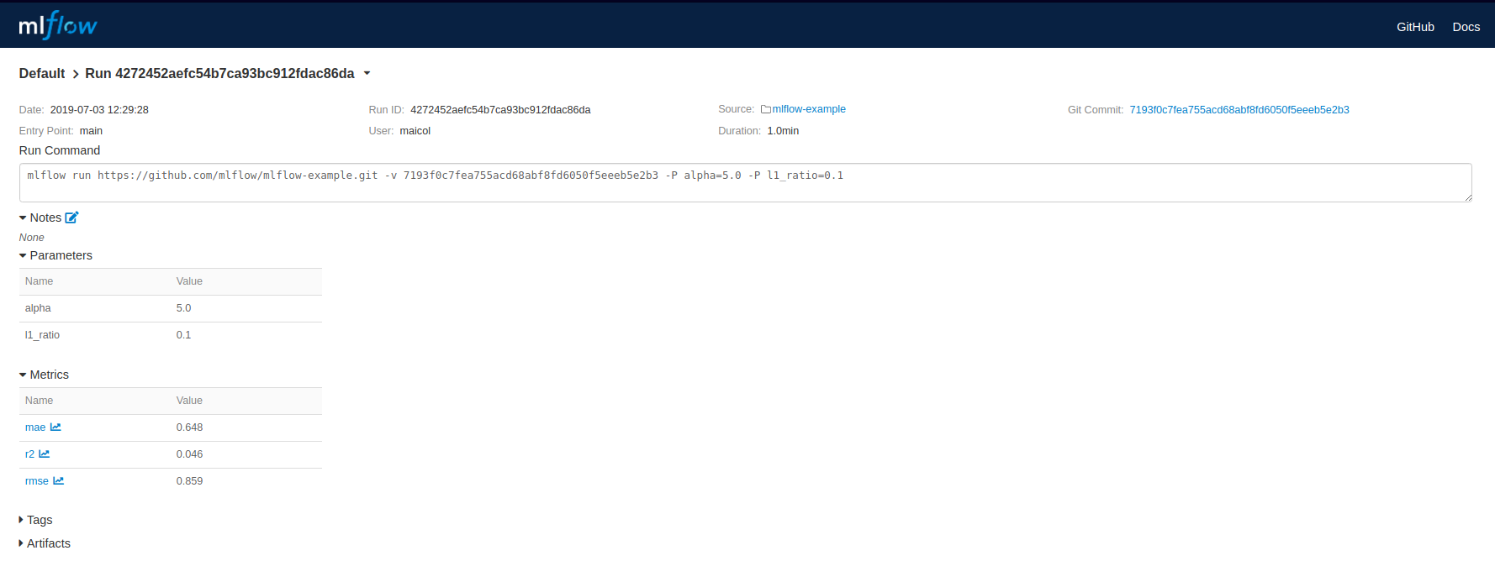
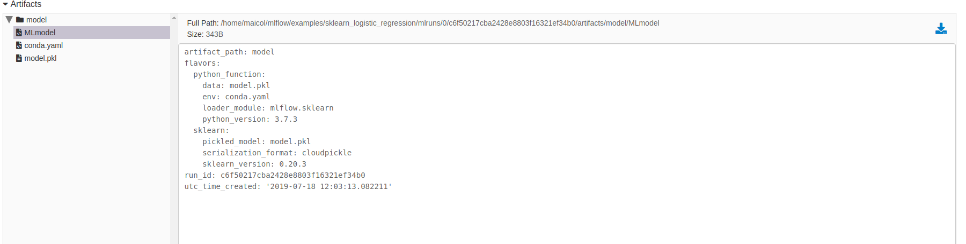
MLFlow UI: Second page
In the second page we can control our parameters and our files.

Slide 11
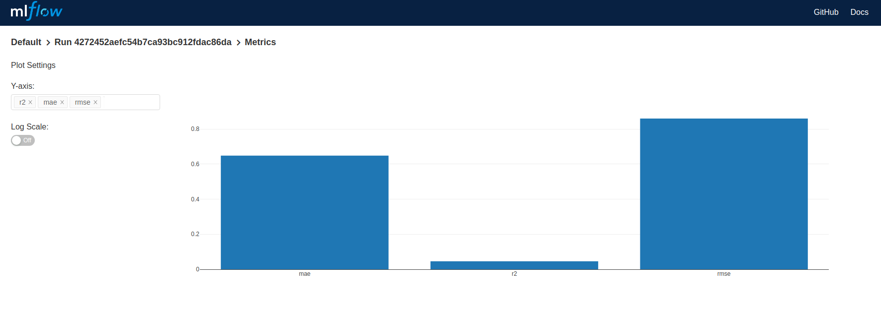
MLFlow UI: Graph Visualization
We also see a graph representation of our metrics, we just need to select the metrics we want to insert and MLFlow return with a plot

Slide 12
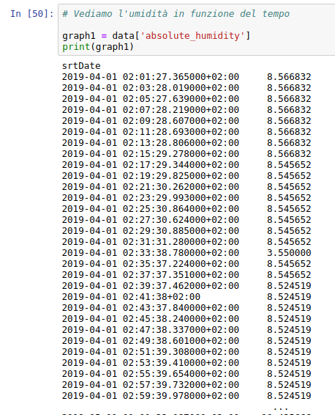
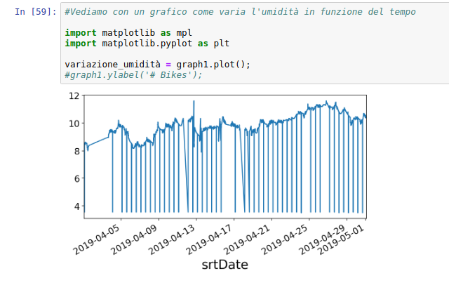
Visualization of Filippetti DataSet
Plot of humidity Value over time
Visualization of humidity value over time

Slide 13
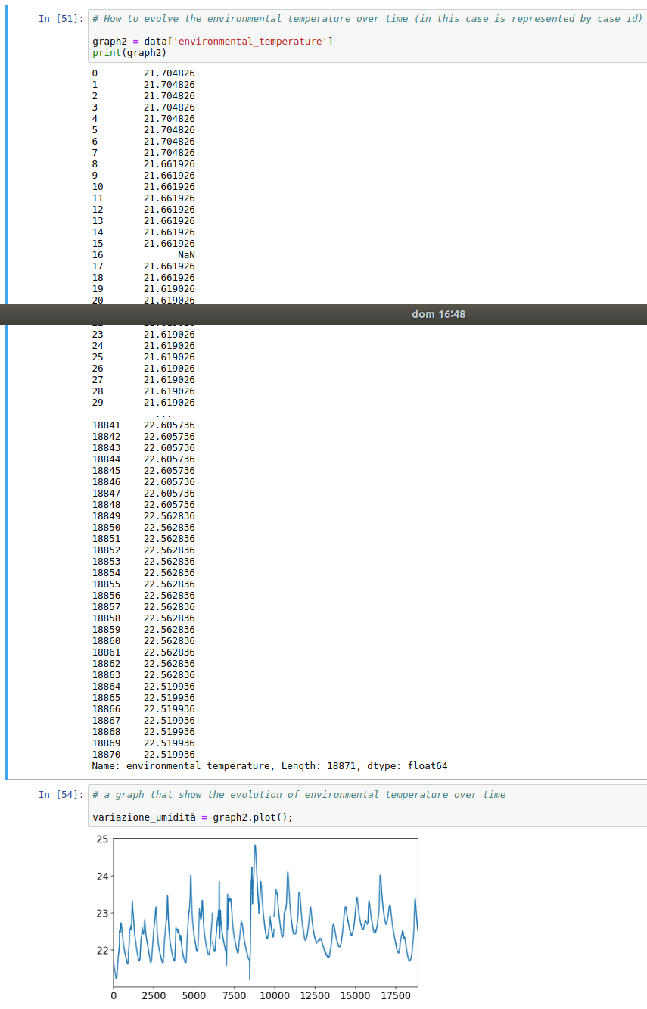
Visualization of Filippetti DataSet
Value and graphical representation of evolution of temperature over time

Slide 14
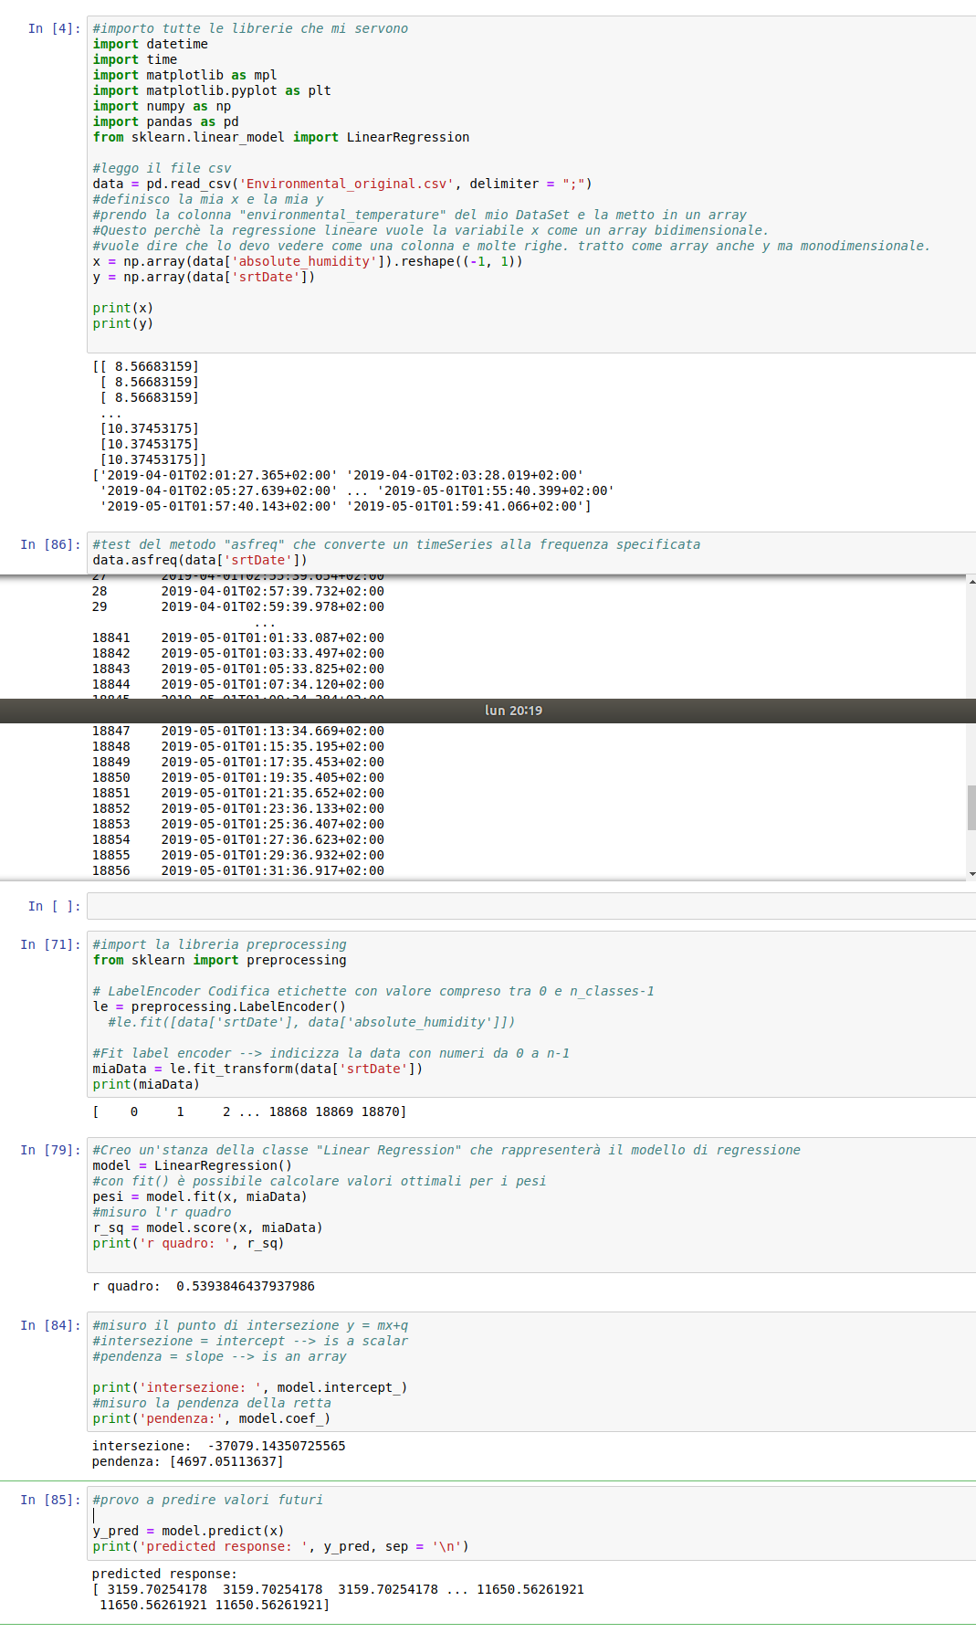
ML with Filippetti dataset
Basic example of the machine learning tecniques in the Filippetti dataset.
This example shows the linear regression of the humidity over time.
R sqr = 0.53
Intercept = -37079
Slope = 4697

Slide 15
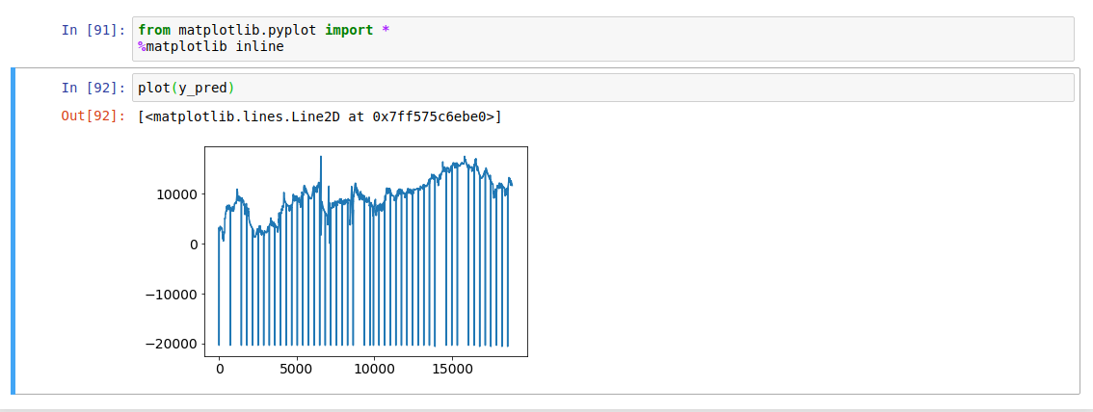
ML with Filippetti dataset
This graph shows the predicted values

Slide 16
Thank You

